Slide 1
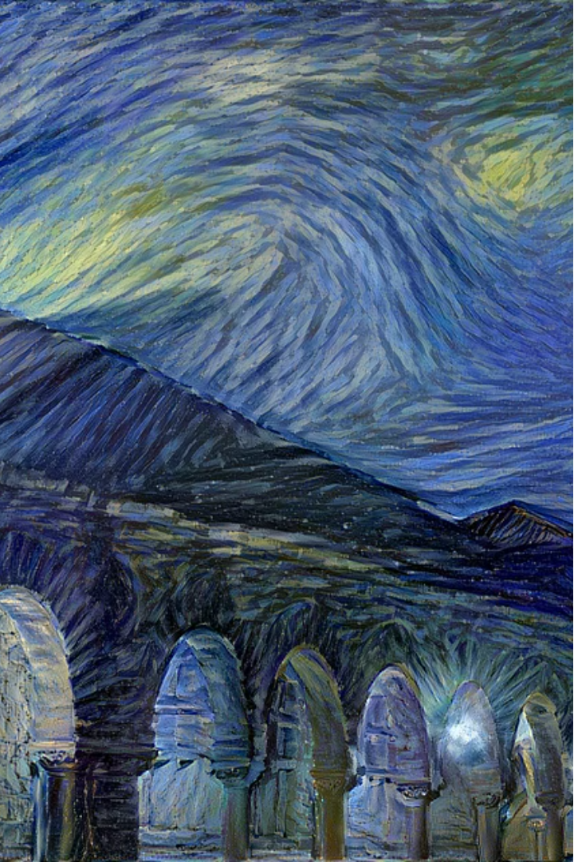

Introduction to Neural Style Transfer
Neural Style Transfer is a powerful technique in machine learning that allows you to blend the content of one image with the artistic style of another. By combining the strengths of Convolutional Neural Networks and Optimization, this algorithm can create stunning, one-of-a-kind visual compositions.

Slide 2
Fundamentals of Machine Learning
1
Supervised Learning
2
Unsupervised Learning
3
Neural Networks
Powerful machine learning models inspired by the human brain that can learn complex functions.
Algorithms that learn from labeled training data to make predictions on new inputs.
Algorithms that discover patterns and structure in unlabeled data.

Slide 3
Overview of Neural Networks
Layers
Activation Functions
Backpropagation
Neural networks are composed of interconnected layers that transform input data into meaningful outputs.
These functions introduce non-linearity and allow neural networks to learn complex patterns.
The training algorithm that efficiently updates the network's weights to minimize error.

Slide 4
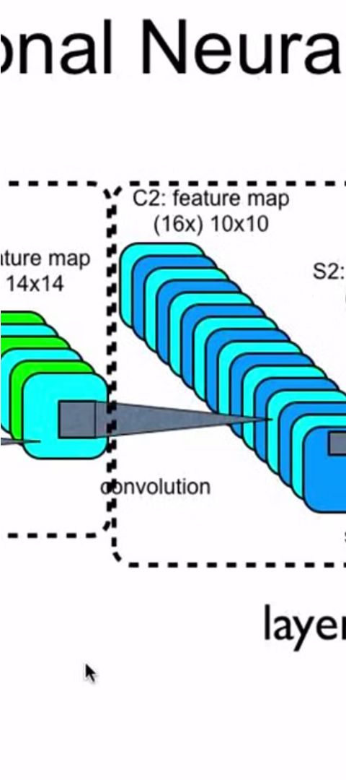
Convolutional Neural Networks (CNNs)
1
Convolution
Applies a set of learnable filters to the input, extracting low-level visual features.
2
Pooling
Reduces the spatial dimensions of the feature maps, providing translation invariance.
3
Dense Layers
The final layers that combine the extracted features to make the desired predictions.

Slide 5
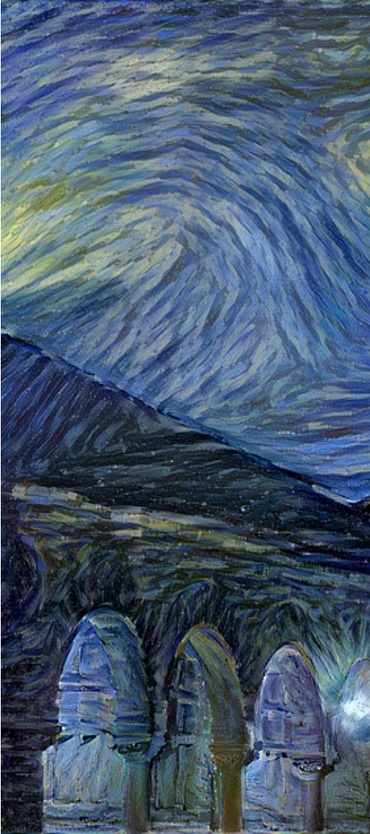
The Neural Style Transfer Algorithm
Content Loss
Style Loss
Measures the difference between the content of the generated image and the content image.
Measures the difference between the style of the generated image and the style image.
Total Loss
Combines the content and style losses to optimize the final generated image.

Slide 6
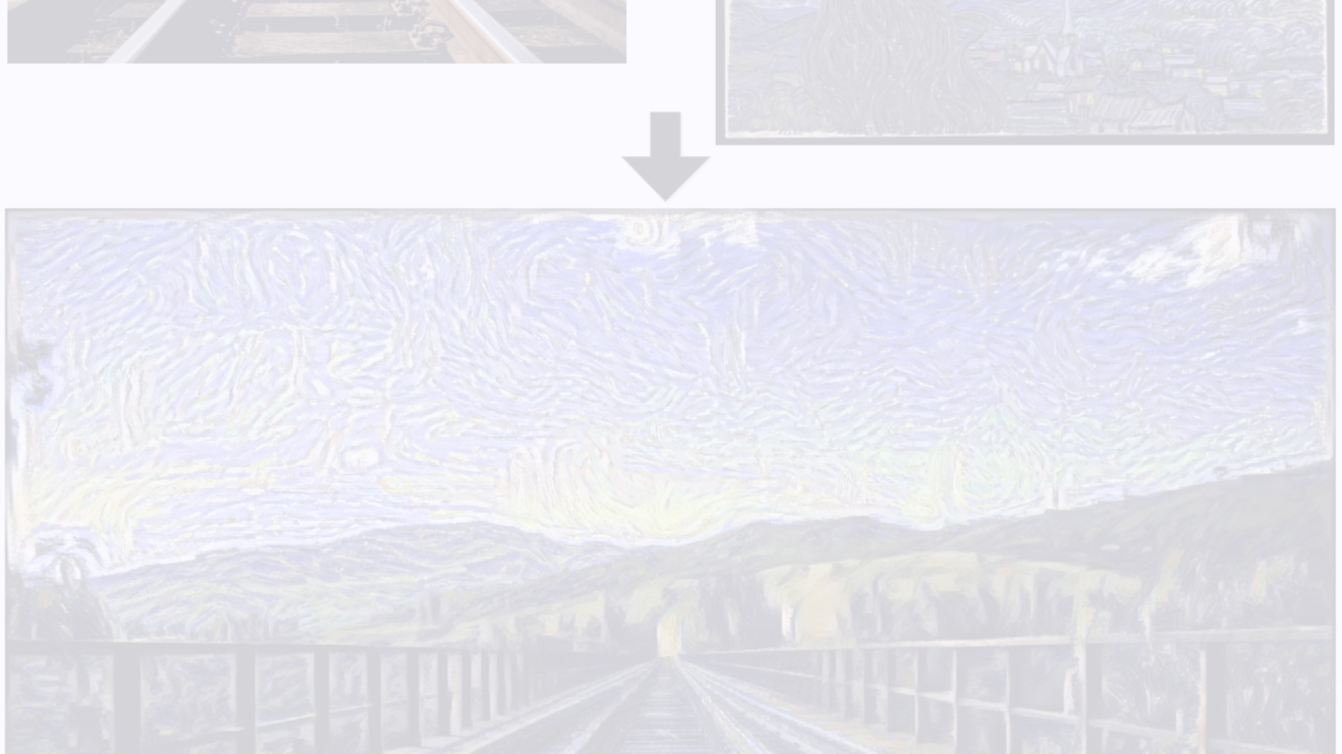
Implementation and Techniques
Pre-trained Models
1
Leverage powerful pre-trained models like VGG-19 to extract content and style features.
2
Gradient Descent
Use gradient-based optimization to iteratively update the generated image to minimize loss.
Hyperparameter Tuning
3
Carefully adjust parameters like content and style weights to achieve the desired output.

Slide 7



Applications and Use Cases
Digital Art
Photo Editing
Video Stylization
Create unique, artistic images by blending the content and style of different sources.
Apply artistic styles to photographs to produce professional-looking, visually compelling images.
Extend the technique to video, allowing for dynamic, real-time style transfer applications.

Slide 8



Conclusion and Future Directions
Advancements
Creativity
Real-time Applications
Continued research and development will lead to more powerful and efficient neural style transfer models.
As the technique evolves, it will empower artists and creators to push the boundaries of visual expression.
The ability to apply styles in real-time will enable new interactive and immersive experiences.

